Slide 1
Supply Analysis
Dr. Bharat Singh
Professor of Economics

Slide 2
Meaning and Definition of Supply
Supply refers to the quantity of a commodity which a producer or seller offers for sale at various prices during a given period of time.
The supply of a commodity is different from the stock of the commodity.
Stock = Total quantity produced-Total quantity sold/supplied.
So, Stock = 0, when Total quantity produced=Total quantity sold/supplied.

Slide 3
Factors Affecting Supply
Supply for a commodity may be affected or determined by the following factors:
Price of the Commodity
Price of the Related Commodity
Prices of the Factors of Production
Supply of Factor and Non-factor Inputs
Technology
Goals of the Firms

Slide 4
Supply Function
SA = f(PA, PR, Pf, SI, T,…….G)
Where,
SA = Quantity supplied of commodity A
PA, = Price of commodity A
PR = Price of related commodity (Complementary and Substitutes)
SI = Supply of inputs
T = Technology
G = Goals of the firm.

Slide 5
Relationship between Price and Quantity Supplied of a Commodity
SA = f(PA)
Other things being the same, the price and quantity supplied of a normal commodity are positively or directly related.
Or, Higher the price, higher the supply and vice-versa.
This is also known as ‘Law of Supply’.

Slide 6
Price of Related Goods and Supply
SA = f(PC)
There exists a positive relationship between price of one commodity and supply for its complementary good.
In case of substitutes, there exists an inverse relationship between price of one good and supply for its substitutes.
SA = f(Ps).

Slide 7
Prices of the Factors of Production and Supply
SA=f(Pf)
Other things being equal, supply of a commodity falls if the prices of the factors and other inputs producing the commodity increase and vice-versa.
A rise in price of even one dominant factor or inputs may negatively affect the supply of the commodity.

Slide 8
Supply of Factors of Production and other Inputs
The supply of a commodity is also determined by the availability of different factor and non-factor inputs at reasonable prices.
The supply of a commodity may be adversely affected even if its prices are rising.
It may happen due to non-availability of some critical inputs (both factor and non-factor) at reasonable prices to produce that commodity.

Slide 9
State of Technology and Supply
SA = f(T)
The state of technology determines the level of supply of a commodity by affecting the efficiency and productivity of the factors of production.
If an economy experiences technological advancement due to discoveries, inventions and innovations favourable for producing a commodity, it obviously helps to increase the supply of that commodity.

Slide 10
Goals of the Firm and Supply
If the goal of the firm is to maximise profit then it would adopt a strategy to maximise the difference between total revenue and the total cost (Total Profit = Total Revenue-Total Cost).
If the goal of the firm is to maximise revenue, then it would continue to produce and supply till its MR=MC and Slope of MC>Slope of MR

Slide 11
Other Factors
Availability and Conditions of Natural Resources – Land, Water and Climate etc.
Means of Transport, Communication and other Infrastructure
Government Policy – Fiscal, Monetary and Trade
Political Conditions – Stability and Policy Sustenance
General Law and Order Conditions

Slide 12
Supply Schedule (Individual Supply of a Firm)
Price (Rs.) | Quantity (units)
4 | 10,000
5 | 12,000
6 | 15,000
7 | 18,000
8 | 20,000

Slide 13
Market Supply
Price | Firm A | Firm B | Firm C | Total Supply (000)
4 | 5 | 6 | 10 | 21
5 | 7 | 8 | 12 | 27
6 | 9 | 10 | 15 | 34
7 | 11 | 13 | 18 | 42
8 | 15 | 18 | 20 | 53

Slide 14
General Law of Supply: Diagram
Y
SS
Price
P3
P2
P1
O
Q1
Q2
Q3
X
Supply

Slide 15
Contraction and Expansion Vs. Increase and Decrease in Supply
Contraction and expansion of supply takes place along the same supply curve and it happens mainly because of the change in price of the good itself.
Increase and decrease in supply takes place through upward or downward shift of the supply curve and it happens due to change in factors other than price of the good itself.

Slide 16
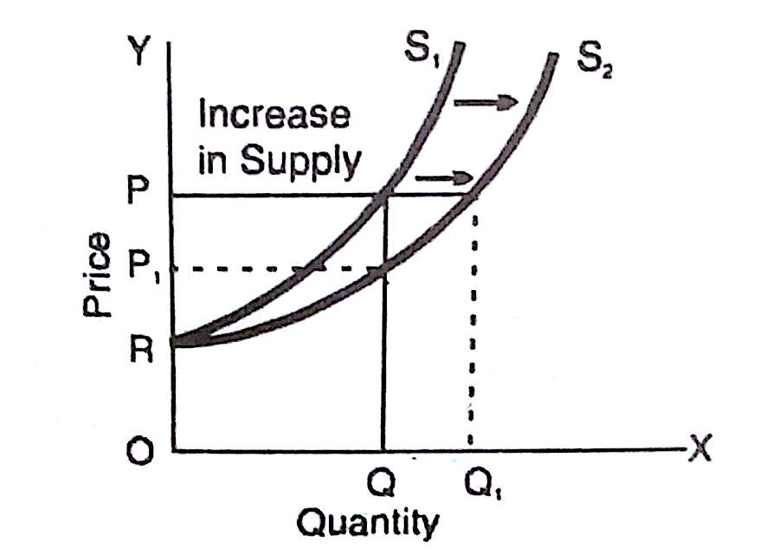
Increase in Supply

Slide 17
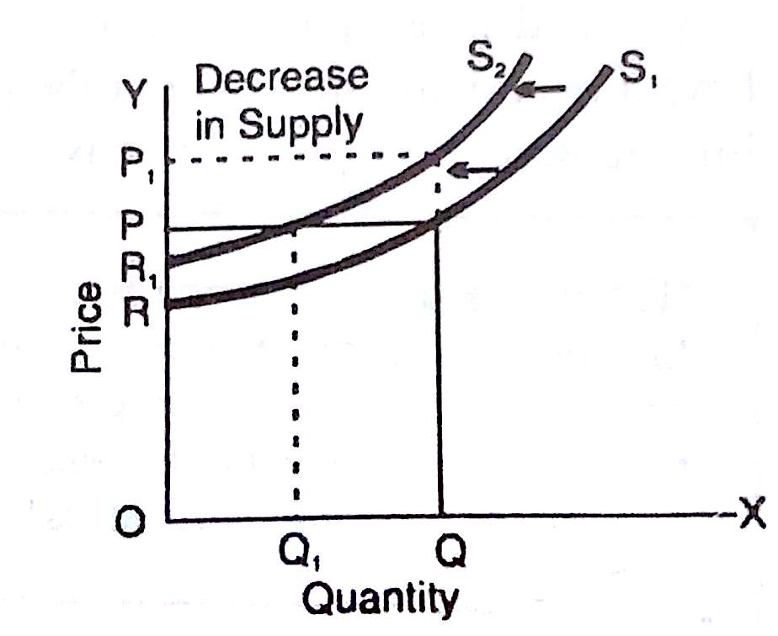
Decrease in Supply

Slide 18
Equilibrium Price
Y
Excess Supply
SS
a
b
P2
Price
E
P0
c
d
P1
Excess Demand
DD
O
Q0
X
Quantity

Slide 19
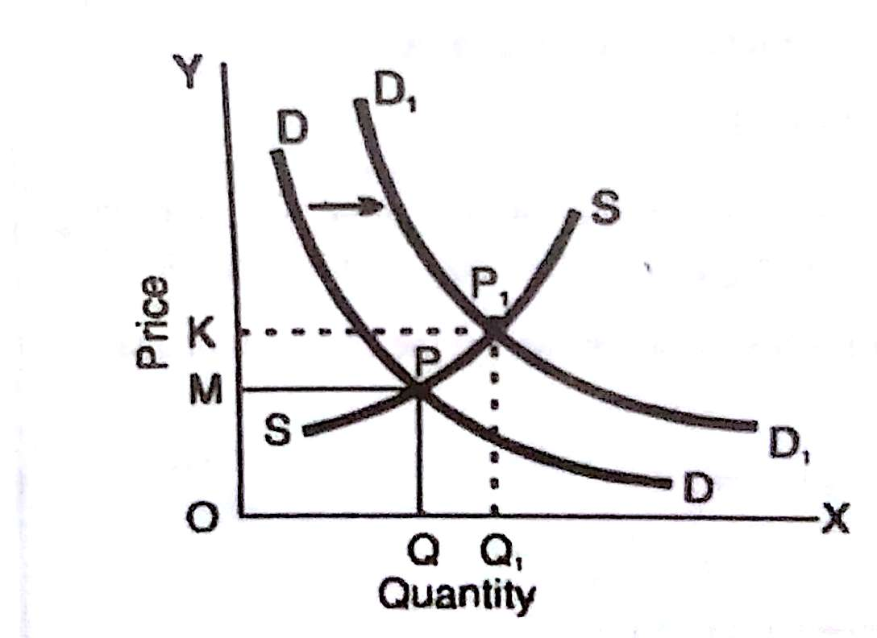
Change in Equilibrium Price

Slide 20
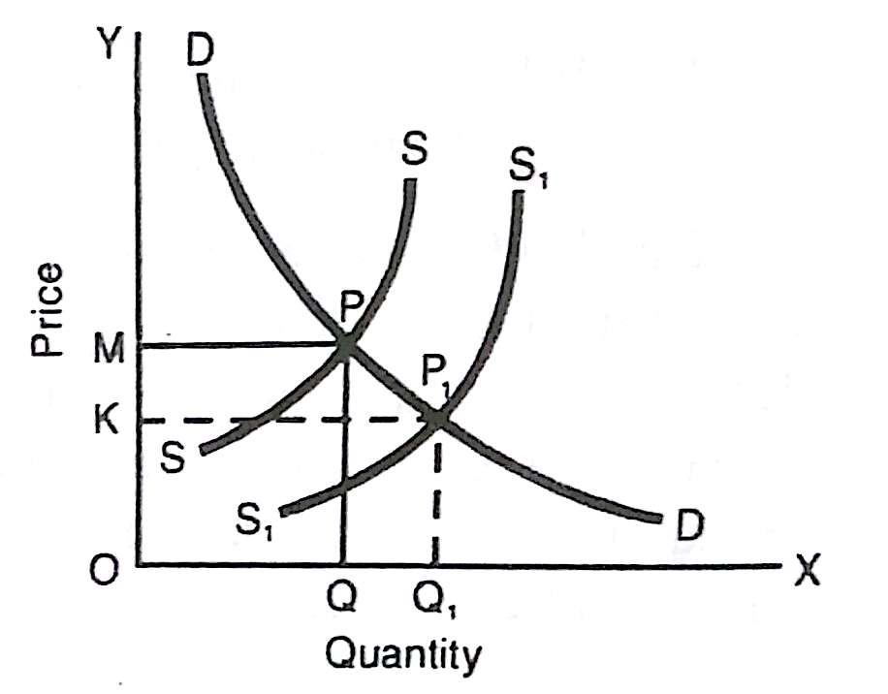
Change in Equilibrium Price

Slide 21
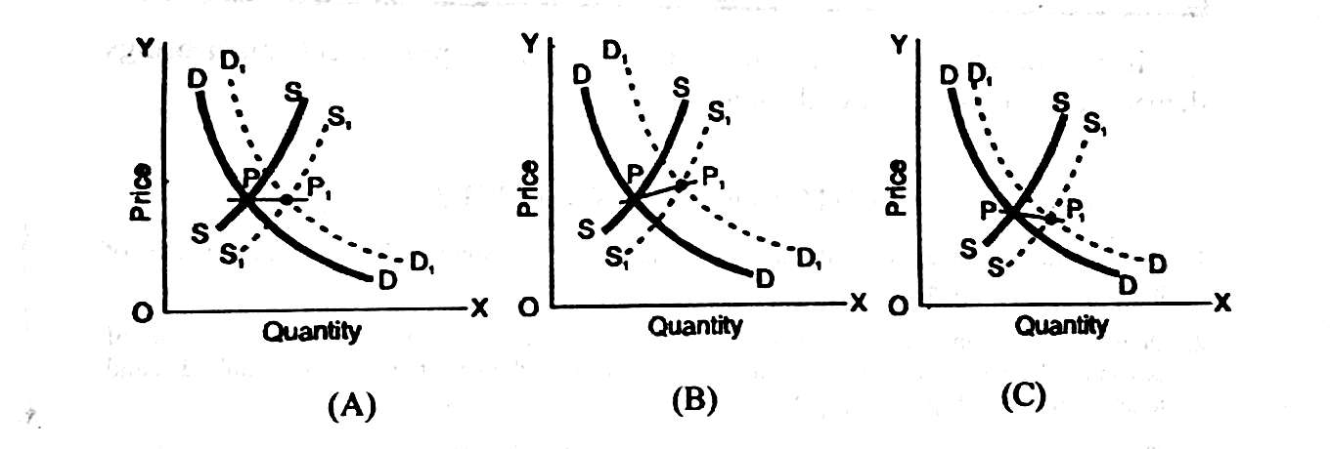
Simultaneous Change in both Demand and Supply

